Slide 1
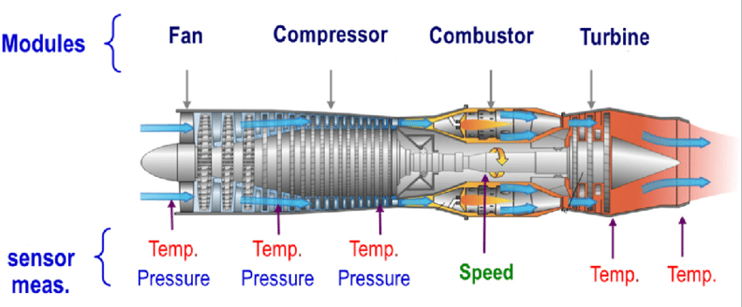
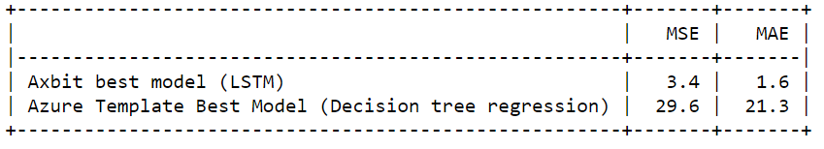
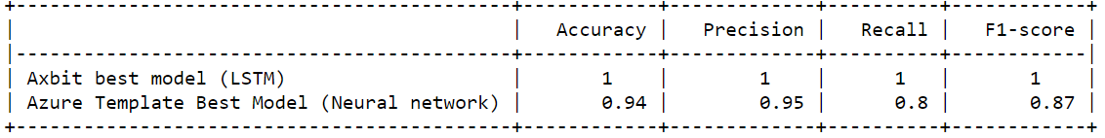
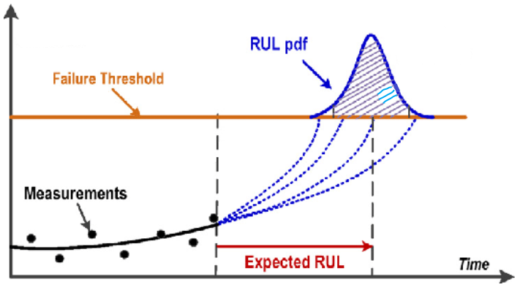
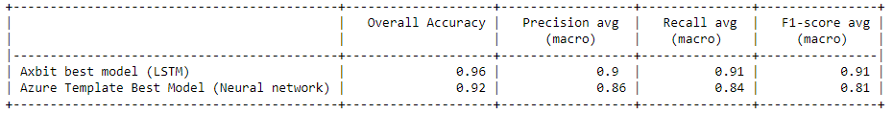
Predictive maintenance In-service aircraft engine
Regression: Predict the Remaining Useful Life (RUL).
Binary classification: Predict if an in-service engine will fail within certain time frame.
Multi-class classification: Predict if an in-service will fail in two different time windows.
Degradation indicator

Slide 2
Technical slides

Slide 3
Time series data and machine learning
Recurrent neural network has recurring connection to itself:
Learns temporal dependence: Gives a sense of time context that can change dynamically.
Native support for sequence: Directly add support for input sequence data.
RNN’s are less brittle towards time dependent nonlinearities.
Recurrent neural network
Feed-forward neural network
Feed-forward ML methods may still work If data is time stationary.

Slide 4
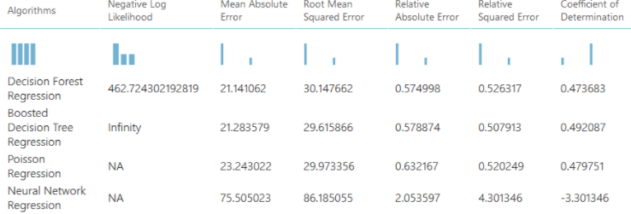
Predictive maintenance – Case example
Data source
https://gallery.azure.ai/Experiment/Predictive-Maintenance-Step-1-of-3-data-preparation-and-feature-engineering-1
Azure team’s solutions:
Predict the Remaining Useful Life (RUL).
Predict if an in-service engine will fail within certain time frame.
Predict if an in-service engine will fail in two different time windows.

Slide 5
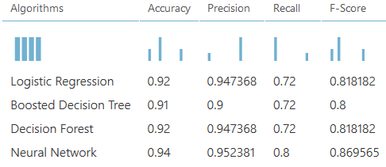
Predictive maintenance – Case example
Data source
https://gallery.azure.ai/Experiment/Predictive-Maintenance-Step-1-of-3-data-preparation-and-feature-engineering-1
Azure team’s solutions:
Predict the Remaining Useful Life (RUL).
Predict if an in-service engine will fail within certain time frame.
Predict if an in-service engine will fail in two different time windows.

Slide 6
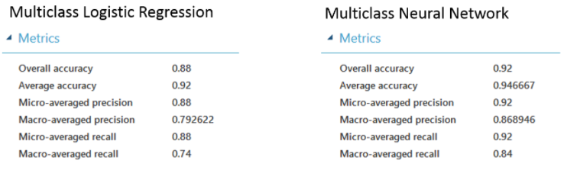
Predictive maintenance – Case example
Data source
https://gallery.azure.ai/Experiment/Predictive-Maintenance-Step-1-of-3-data-preparation-and-feature-engineering-1
AzureML team’s solutions: (Using template on machine learning studio on azure)
Predict the Remaining Useful Life (RUL).
Predict if an in-service engine will fail within certain time frame.
Predict if an in-service engine will fail in two different time windows.

Slide 7
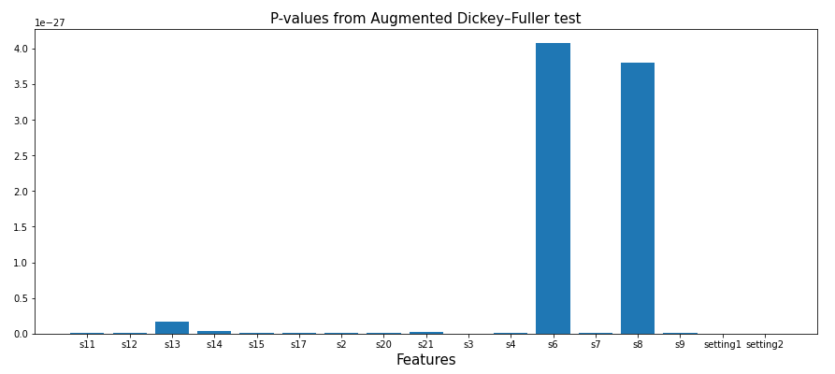
Predictive maintenance – Case example
Pre-Analysis:
A. D. Fuller to test the null hypotheses
“Data is time stationary”.
RNN’s LSTM should do better in capturing the time dependent nonlinear patterns.
All features are non-stationary

Slide 8
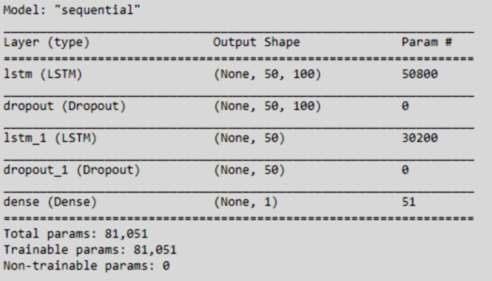
Predictive maintenance – Case example
Pre-Analysis:
A. D. Fuller to test the null hypotheses
“Data is time stationary”.
RNN’s LSTM should do better in capturing the time dependent nonlinear patterns.
All features are non-stationary
LSTM network:
Sequence length (time units): 50.
Number of units (number of hidden states): 100.
Two LSTM blocks
Two dropout layers, both will drop 20% of the units from linear transformation of the inputs.
A dense layer at the end with
‘Sigmoid’ activation function for binary classification.
‘Softmax’ for multiclass.
‘linear’ for regression.

Slide 9
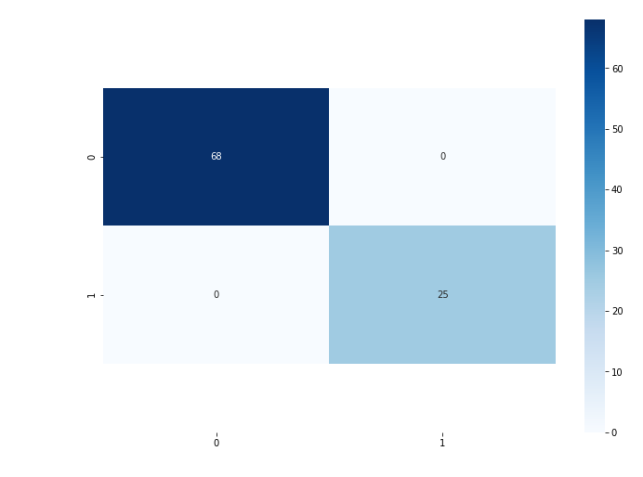
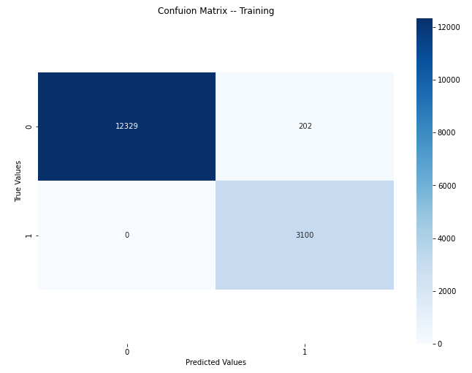
Binary classification
Confusion matrix - test data
Class label = 1, If an in-service engine will fail in next w0 time-units window.

Slide 10
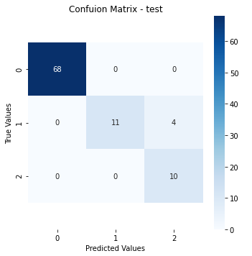
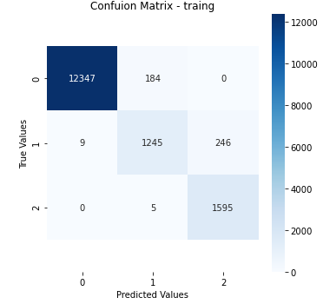
Multiclass classification
Class label = 1, If an in-service engine will fail in next w0 time-units window.
Class label = 2, if an in_service engine will fail within w0 and w1, w1 > w0.

Slide 11
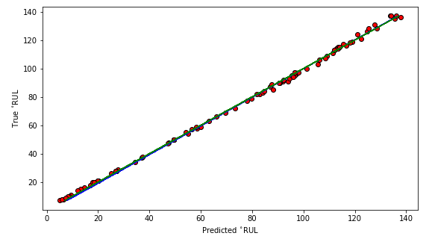
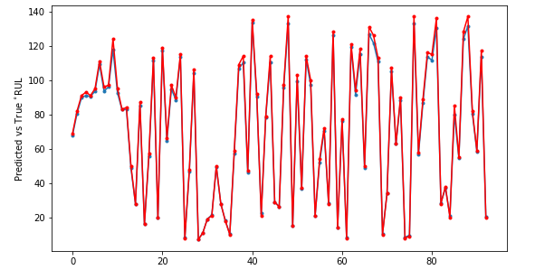
Regression

